Slide 1
Then shall the dust return to the earth as it was: and the spirit shall return unto God who gave it. Eccl 12:7 (KJV)
Music: “Mansions of our Lord” from the movie – A Bridge Too Far, performed by the US Military Academy Glee Chorus

Slide 17
And it came to pass, that the beggar died, and was carried by the angels into Abraham's bosom Luke 16:22 (KJV)

Slide 18
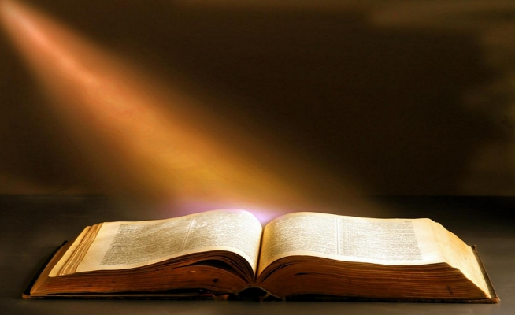
In the beginning was the Word, and the Word was with God, and the Word was God. 2 The same was in the beginning with God. 3 All things were made by him; and without him was not any thing made that was made. 4 In him was life; and the life was the light of men. John 1:1-4 (KJV)
I am the bread of life: he that cometh to me shall never hunger; and he that believeth on me shall never thirst. John 6:35 (KJV)

